Slide 1
INSOMNIA- SYMPTOM OR DISORDER? HOW TO MANAGE!
I
N
S
O
M
N
I
A
Professor Quazi Tarikul Islam
FCPS, FACP, FRCP
Prof. of Medicine
Dhaka Medical College

Slide 2
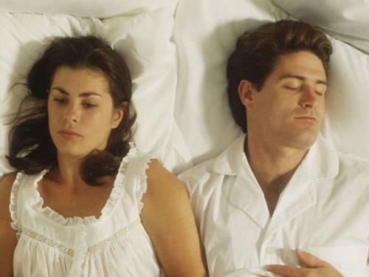

Slide 3
Sleep condition of the doctors who attended
I
N
S
O
M
N
I
A
Among the total 265 doctors-
  Good sleeper- 63 (24%)
  Sleep debt- 199 (75%)
  Exhausted- 3 (1%)

Slide 4
Sleep
Sleep is a state of unconsciousness in which the brain is relatively more responsive to internal than to external stimuli
Mechanisms within the brainstem and hypothalamus regulate sleep through GABA and acetylcholine
I
N
S
O
M
N
I
A

Slide 5
Important facts
Sleep disorders are common
Sleep disorders are serious
Sleep disorders are treatable
Sleep disorders are under diagnosed
I
N
S
O
M
N
I
A

Slide 6
Circadian sleep rhythm
One of several intrinsic rhythms modulated by the hypothalamus
Without external stimulus, the suprachiasmatic nucleus sets the rhythm to approximately 25 hours
A nerve tract directly from the retina helps regulate us to 24 hours days.
Melatonin is a modulator of light entrainment and is secreted maximally by the pineal gland during the night
I
N
S
O
M
N
I
A

Slide 7
Determinants of Sleep
Biological Clock
Homeostatic Sleep Drive
Social/External Factors
Intrinsic Illness
I
N
S
O
M
N
I
A
Kryger MH, Roth T, Dement WC, eds. Principles and Practice of Sleep Medicine. Philadelphia,
Pa: Elsevier Saunders; 2005.
Notes:
52
52

Slide 8
Sleep Requirements
Average - 7 to 8 hrs/night
Range (for adults) - 5-9 hrs/night
Steadily decreases from birth to old age
newborns sleep 14-16 hours/24 hours
Elderly spend less time sleeping per night, but increase in sleep latency and more frequent arousals make their requirement in bed longer.
I
N
S
O
M
N
I
A

Slide 9
Age & Sleep
Age Group | Considered Amount of Sleep Needed (1) | Average % REM Sleep
Infants | 16 - 18 hrs/day | 50%
Toddlers | 10-12 hrs/night; 1-2 hrs/day | 35%
Children | 9-10 hrs/night; infrequent naps
Teenagers | 9.5 hrs/night
Adults | 7-8.5 hrs/night | 20-25%
Elders | 6.5 hrs/night; 1 hr nap
I
N
S
O
M
N
I
A

Slide 10
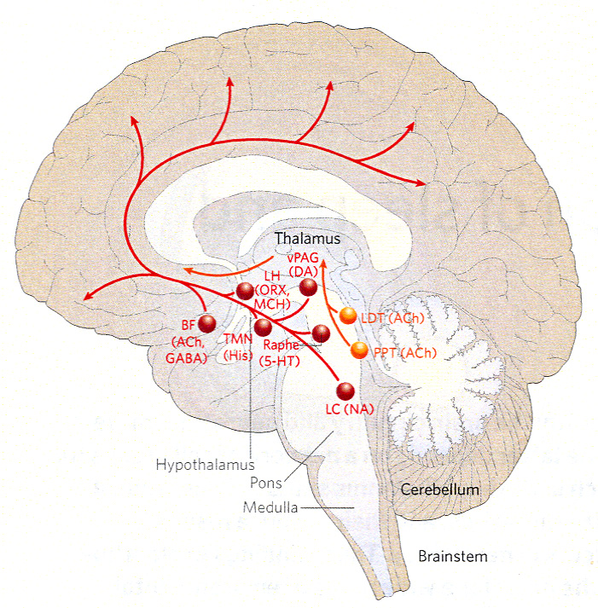
Notes:
The ascending arousal system largely originates has two major branches. 1) An ascending pathway to the thalamus that activates the thalamic relay neurons that are crucial for transmission of information to the cerebral cortex. The major source of upper brainstem input to the thalamic-relay nuclei, as well as to the reticular nucleus of the thalamus, is a pair of acetylcholine-producing cell groups: the pedunculopontine and laterodorsal tegmental nuclei (PPT/LDT). The neurons of the PPT/LDT fire most rapidly during wakefulness and REM and are much less active in NREM. Their input to the reticular nucleus of the thalamus is crucial because it sits between the thalamic-relay nuclei and cerebral cortex, acting as a gating mechanism that can block transmission between the thalamus and cerebral cortex.
2) The second system bypasses the thalamus and instead activates neurons in the lateral hypothalamic area and basal forebrain, and throughout the cerebral cortex. This pathway originates from monoaminergic neurons in the upper brainstem and caudal hypothalamus, including the noradrenergic locus coeruleus, serotoninergic dorsal and median raphe nuclei, dopaminergic ventral periaqueductal grey matter and histaminergic tuberomammillary neurons. The input to the cerebral cortex is augmented by lateral hypothalamic peptidergic neurons (MCH or orexin/hypocretin) and BF neurons (Ach, GABA). Lesions here produce profound and long-lasting sleepiness, even coma. These neurons fire during wakefulness, slow down during NREM sleep, and stop during REM sleep. Orexin/hypocretin neurons in the LHA are most active during wakefulness whereas MCH neurons are active during REM sleep.

Slide 11
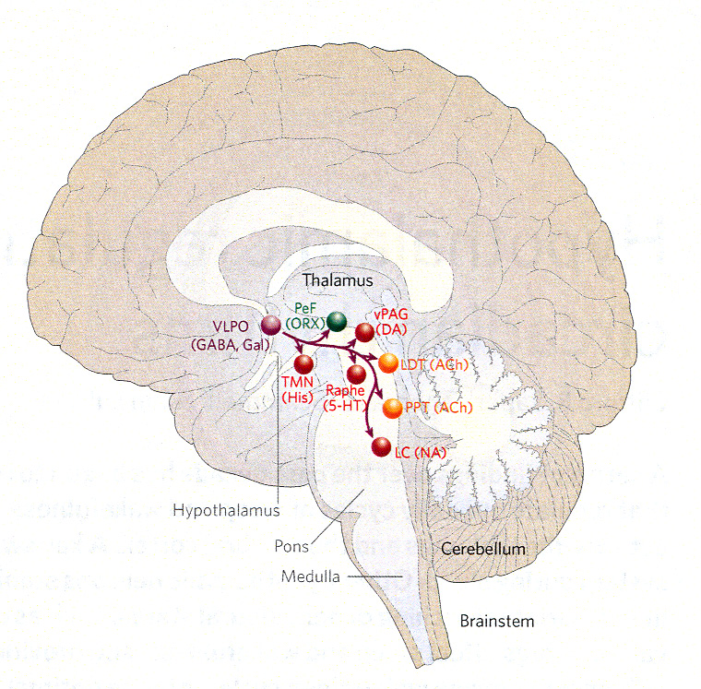
Notes:
VLPO promotes sleep. VLPO lesions produce insomnia. VLPO active primarily during sleep – GABA and galanin: these neurons form a dense cluster as well as a more diffuse extended area. Lesions of the VLPO cluster reduces NREM sleep, whereas lesions of the extended VLPO disrupts REM sleep. Extended VLPO projects primarily to LC and DR. VLPO cluster projects more heavily to histaminergic neurons which are closely linked to transitions between arousal and NREM sleep.
The VLPO also receives afferents from each of the major monoaminergic systems – noradrenaline and serotonin inhibit VLPO neurons. GABA from tuberomammillary neurons inhibit VLPO. Therefore the VLPO is inhibited by the very systems that it inhibits.

Slide 12
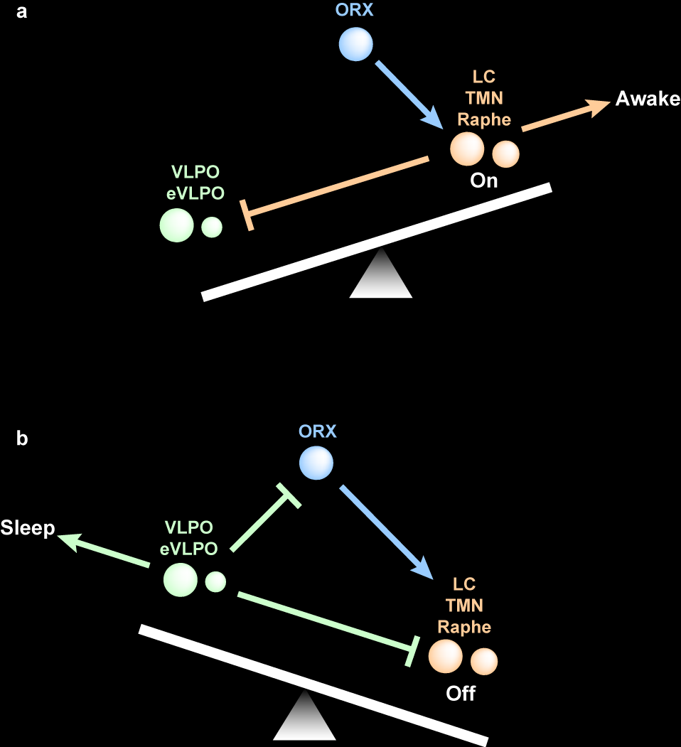
Notes:
A circuit containing mutually inhibitory elements sets up a self-reinforcing loop, where activity in one of the competeing sides shuts down inhibitory inputs from the other side, and therefore disinhibits its own action. Mathematical models show that when either side of a flip-flop circuit is weakened, homeostatic forces cause the switch to ride closer to its transition point during both states. As a result, there is an increase in transitions, both during the wake and the sleep periods, regardless of which side is weakened. This is seen in animals with VLPO lesions which fall asleep about twice as often as normal animals, wake up much more often during their sleep cycle and, on the whole, only sleep for about ¼ as long per bout. Similar to elderly patients who experience age related loss of VLPO neurons.
Orexin/hypocretin produced in the posterior half of the LHA. These neurons are active during wake especially during motor activity when animals actively explore their environment. These neurons reinforce the arousal system but don’t inhibit the VLPO. This may stabilize the “flip-flop” switch (like a finger).
Homeostatic sleep drive may be related to accumulation of adenosine which may activate VLPO.

Slide 13
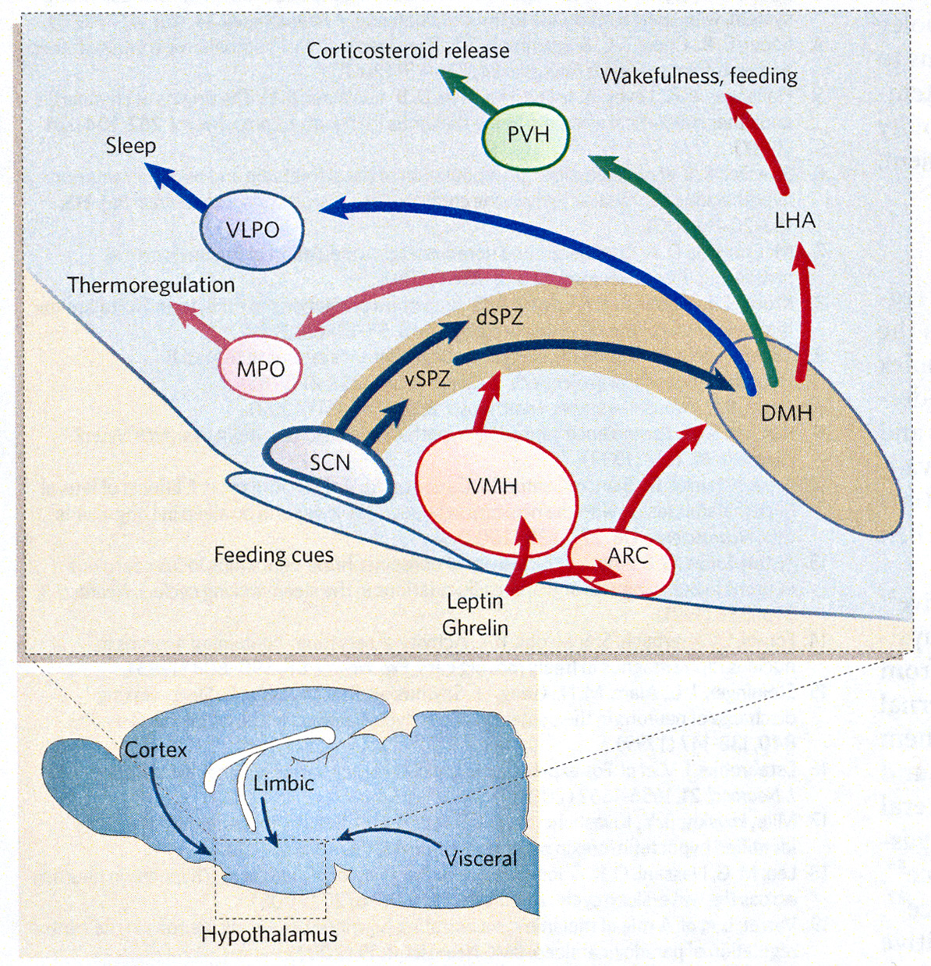
I
N
S
O
M
N
I
A
Notes:
SCN’s major projections are to adjacent subparaventricular zone (SPZ) and the dorsomedial nucleus of the mypothalamus (DMH). This has a SPZ ventral part (lesions of ventral SPZ disrupt the circadian rhythms of sleep and wakefulness as well as locomotor activity, but have minimal effects on body-temperature) and SPZ dorsal (lesions of dorsal SPZ severly impair circadian rhythms of body temperature but not wake-sleep or locomotor activity).
Major target of SPZ isnthe DMH. The DMH receives many more input from SPZ than SCN thus the SPZ can amplify the output of the SCN. DMH lesions profoundly diminish circadian rhythms of sleep and wakefulness, as well as locomotor activity, corticosteroid secretion, and feeding.
The DMH is one of the largest sources of input to the VLPO and orexin neruons and is crucial for conveying SCNH influences to the wake-sleep-regulatory system. DMH to VLPO comes largely from GABA (promotes wake by inhibiting sleep). DMH projects to LHA (glutamate and TRH). DMH more active during wake than sleep.
Why so complicated? SCN is always active during light and the VLPO is always active during sleep. Nocturnal/dirunal animals must have circuitry allowing for circadian cycles to be set in opposite phases, despite an identical clock input and sleep-control system. Finland bats.

Slide 14
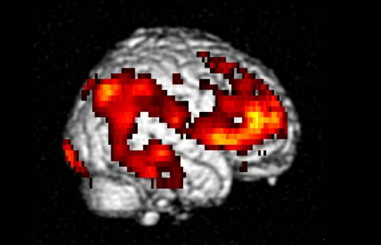
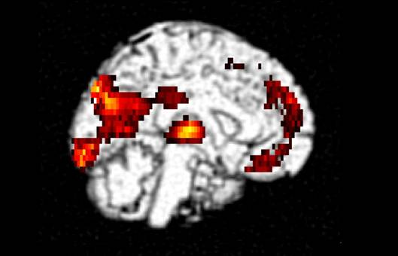
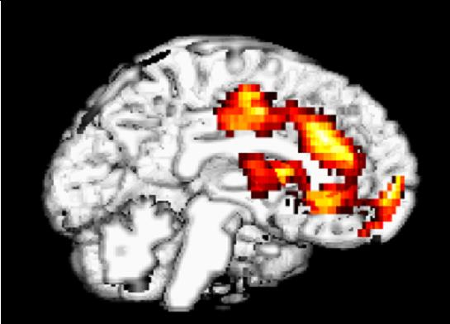
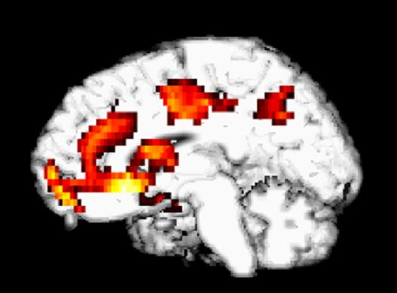
Functional Neuroanatomy of Sleep in Healthy Adults
Relative Glucose Metabolism
I
N
S
O
M
N
I
A
Wake → NREM
Wake → REM
Nofzinger EA et al. Psychiatry Res. 1999;91:59-78.
Notes:
OPTIONAL

Slide 15
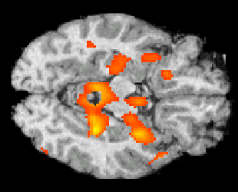
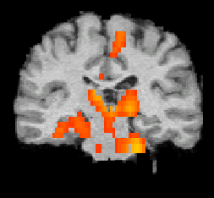
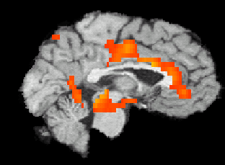
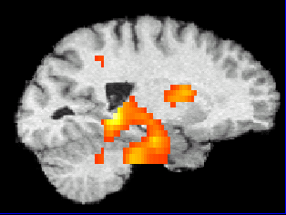
Areas That Deactivate Less During NREM Sleep vs Waking in Insomnia Subjects vs Controls
Hypothalamus
Thalamus
ARAS
I
N
S
O
M
N
I
A
Mesial temporal cortex
ARAS
Anterior cingulate cortex
Insula
ARAS
Hypothalamus
Mesial temporal cortex
ARAS = Ascending Reticular Activating System.
Nofzinger EA et al. Am J Psychiatry. 2004;161(11)2126-9.
Notes:
CORE

Slide 16
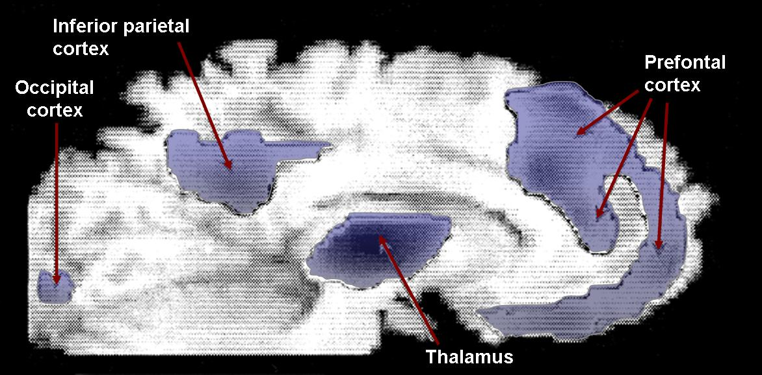
Sleep Deprivation Is Associated With Decreased Cortical Activity
¹⁸FDG PET Study of Healthy, Sleep-Deprived Adults, Showing Decreased Metabolism in the Thalamus, Prefrontal Cortex, and Inferior Parietal Cortex
I
N
S
O
M
N
I
A
Inferior parietal
cortex
Prefrontal
cortex
Occipital
cortex
Thalamus
FDG, fluorodeoxyglucose; PET, positron emission tomography
Thomas M et al. J Sleep Res. 2000;9:335-352.
Notes:
OPTIONAL

Slide 17
Wake System
I
N
S
O
M
N
I
A

Slide 18
Sleep System
I
N
S
O
M
N
I
A

Slide 19
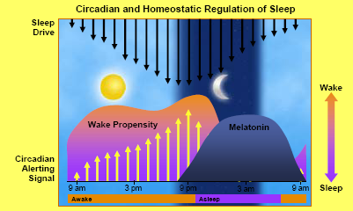
Sleep Wake Cycle
I
N
S
O
M
N
I
A

Slide 20
Changes in sleep with age
I
N
S
O
M
N
I
A

Slide 21
Sleep/Wake Neurotransmitters and Modulators: Targets for Pharmacologic Development
Wake
Norepinephrine
Serotonin
Acetylcholine
Histamine
Orexin/hypocretin
Sleep
Adenosine
γ-aminobutyric acid (GABA)
Galanin
Melatonin
I
N
S
O
M
N
I
A
Notes:
OPTIONAL

Slide 22
Sleep stages
We cycle through the stages of sleep about every 90 minutes during the night, in the same order
Most dreaming occurs during the second half of the night, as REM sleep lasts longer and longer
NREM Sleep
  Stage 1: Very light sleep
  Stage 2: Light sleep
  Stage 3: Deeper sleep
  Stage 4: Very deep sleep, most restorative
REM Sleep
  Stage 5: REM sleep, when we dream
I
N
S
O
M
N
I
A

Slide 23
Sleep Stages
Wake
2/3 of life
I
N
S
O
M
N
I
A
NREM Sleep
~80% of night
REM Sleep
~20% of night

Slide 24
REM sleep
Generated by mesencephalic and pontine cholinergic neurons
Characterized by muscle atonia, cortical activation, low voltage desynchronization of the EEG, and rapid eye movements
I
N
S
O
M
N
I
A

Slide 25
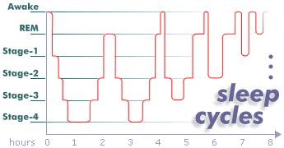
Electrophysiology
Three States:
Wakefulness
Slow-wave sleep - NREM
  Non-Rapid Eye Movement
  characterized by EEG
  divided in four stages
  first NREM lasts about 90 min
  NREM: 75-80% of sleep
Paradoxic sleep - REM
  Rapid Eye Movement
  characterized by EEG
  dreaming occurs
  REM: 20-25% of sleep
I
N
S
O
M
N
I
A

Slide 26
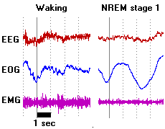
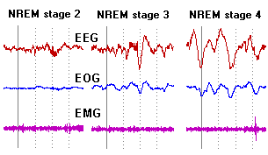

Stages of Sleep
I
N
S
O
M
N
I
A
Stage | % spent during sleep | Frequency (cycles per second) | Amplitude (microvolts) | Wave type
Awake | N/A | >12 |  | beta
Awake (Relaxed) | N/A | 8-12 |  | alpha
REM | 25% | >12 |  | beta
NonREM 1 | 5% | 4-8 | 50-100 | theta
NonREM 2 | 45% | 8-15 | 50-150 | theta, spindles, & K-complexes
NonREM 3 | 12% | 2-4 | 100-150 | delta & theta
NonREM 4 | 13% | .5-2 | 100-200 | delta & theta

Slide 27
Age
Some differences:
Infants
  cyclic alteration of NREM-REM sleep: 50-60 min
  gradually develop normal nocturnal slow wave sleep NREM
  stages 3 and 4 after 2-6 months of life
  Slow wave sleep becomes maximal in young children
Young Adults
  cyclic alteration of NREM-REM sleep: 90 min
Adults
  Slow wave sleep decreases markedly with age
  slow wave sleep (3&4) no longer exists by 60 years of age
  more so in men than in women
I
N
S
O
M
N
I
A

Slide 28


Hypnogram
Awake
REM
1
Sleep Stages
2
I
N
S
O
M
N
I
A
3
4
Middle-aged Adult
Awake
REM
1
Sleep Stages
2
3
4
Older Adult
Hours of Sleep
Notes:
OPTIONAL

Slide 29
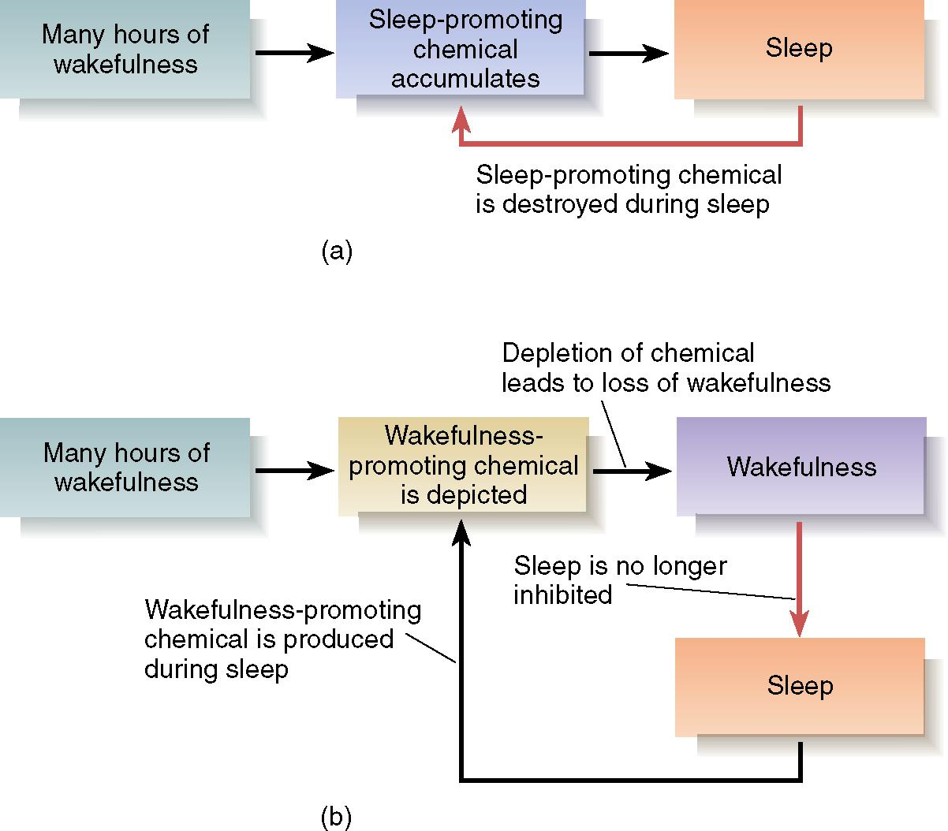
I
N
S
O
M
N
I
A

Slide 30
Physiological Mechanisms of Sleep and Waking
  Neural Control of Arousal
  Acetylcholine:
    One of the most important neurotransmitters involved in arousal.
    Two groups of acetylcholinergic neurons located in the pons and basal forebrain, produce activation and cortical desynchrony when they are stimulated
I
N
S
O
M
N
I
A

Slide 31
Physiological Mechanisms of Sleep and Waking
  Neural Control of Arousal
  Norepinephrine:
    Catecholamine agonists produce arousal and sleeplessness; effects appear to be mediated by the locus coeruleus in the dorsal pons.
  Locus ceoruleus:
    A dark-colored group of noradrenergic cell bodies located in the pons near the rostral end of the floor of the fourth ventricle; involved in arousal and vigilance.
I
N
S
O
M
N
I
A

Slide 32
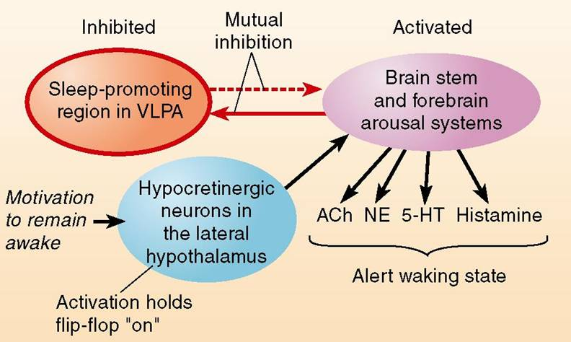

Slide 33
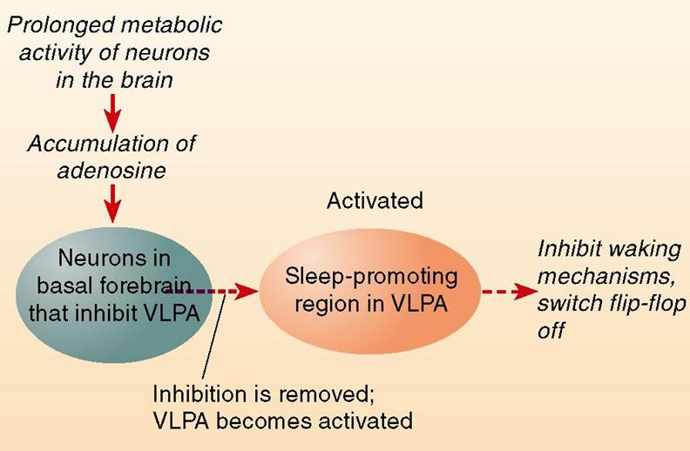

Slide 34
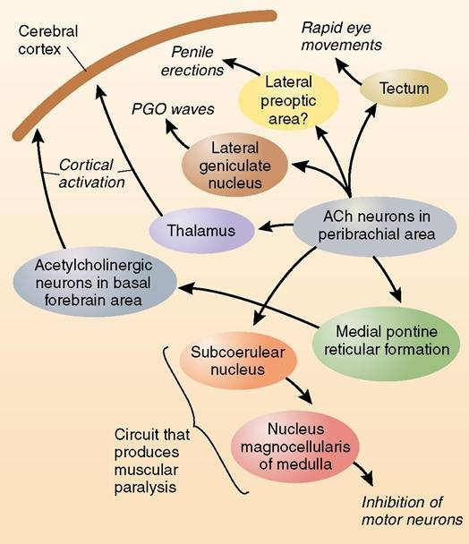
Copyright © 2004 Allyn and Bacon

Slide 35
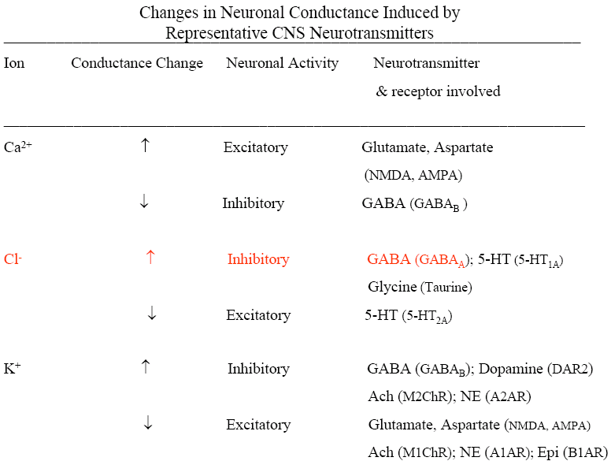

Slide 36
Sleep disorders
Insomnia.
Sleep Related Breathing Disorders.
Hypersomnia.
Cicadian Rhythm Sleep Disorder.
Parasomnia.
Sleep related Movement Disorder.
I
N
S
O
M
N
I
A

Slide 37
Insomnia
Insomnia is defined as difficulty with the initiation, maintenance, duration, or quality of sleep that results in the impairment of daytime functioning, despite adequate opportunity and circumstances for sleep.
Patient’s subjective dissatisfaction with the sleep quality and quantity
I
N
S
O
M
N
I
A

Slide 38
Insomnia Definition
(Research Diagnostic Criteria)
The individual reports one or more of the following
sleep-related complaints:
  Difficulty initiating sleep
  Difficulty maintaining sleep
  Waking up too early, or
  Sleep that is chronically nonrestorative or poor in quality
The above sleep difficulty occurs despite adequate opportunity and circumstances for sleep
I
N
S
O
M
N
I
A
Edinger JD et al. Sleep. 2004;27:1567-1596.
Notes:
CORE

Slide 39
Insomnia Definition
(Research Diagnostic Criteria)
At least one of the following forms of daytime impairment
related to the nighttime sleep difficulty is reported by
the individual:
  Fatigue/malaise
  Attention, concentration, or memory impairment
  Social/vocational dysfunction or poor school performance
  Mood disturbance/irritability
  Daytime sleepiness
  Motivation/energy/initiative reduction
  Proneness for errors/accident at work or while driving
  Tension headaches, and/or GI symptoms in response to sleep loss
  Concerns or worries about sleep
I
N
S
O
M
N
I
A
Edinger JD et al. Sleep. 2004;27:1567-1596.
Notes:
CORE

Slide 40
Insomnia - definition
Insomnia is not defined by the number of hours of sleep, but rather, by an individual‘s ability to sleep long enough to feel healthy and alert during the day.
The normal requirement for sleep ranges between 4 and 10 hours
Insomnia is a symptom, not a disorder by itself
I
N
S
O
M
N
I
A

Slide 41
Evolving Attitudes
 | NIH – 1983 | NIH – 2005
Definition | Insomnia is a symptom, not a primary disorder | Insomnia is a disorder, typically comorbid with other disorders
Treatment | Treat the primary disorder (insomnia symptoms are sometimes addressed, sometimes ignored) | Chronic insomnia exists and merits treatment
 | Hypnotics should generally be used only for short-term treatment | Treat insomnia as well as other disorder(s): improvements in insomnia may result in improvements in other disorder(s)
Other | Chronic insomnia occurs in the context of medical/psychiatric disorders | Insomnia is associated with significant impairment in function and quality of life
I
N
S
O
M
N
I
A
Notes:
CORE

Slide 42
Disorders of Sleep
  Insomnia
    Reported to affect approximately 25% of the population occasionally, and 9% regularly.
    There appears to be no single definition of insomnia.
    One of the most important causes of insomnia seems to be sleeping medication.
    Insomnia is not a disease, but rather may be a symptom of pain, discomfort, or other physical ailment.
I
N
S
O
M
N
I
A

Slide 43
Insomnia Is Not Sleep Deprivation
Insomnia diagnosis assumes adequate opportunity to sleep
Sleep deprivation
  Adequate ability to sleep
  Inadequate opportunity
Insomnia patients
  Inadequate ability to sleep
  Adequate opportunity
I
N
S
O
M
N
I
A
Bonnet MH, Arand DL. Sleep. 1995;18:581-588.
Bonnet MH, Arand DL. Psychosom Med. 1997;59:533-540.
Stepanski E et al. Sleep. 1988;11:54-60.
Notes:
OPTIONAL

Slide 44
Why Insomnia?
I
N
S
O
M
N
I
A
New research suggests there is a need to change the way insomnia is treated in clinical practice
Our aim is to communicate the new research and discuss the implications for improving clinical practice
Notes:
OPTIONAL

Slide 45
Primary vs Comorbid Insomnia
No DSM-IV Diagnosis
24%
Psychiatric Disorders
44%
I
N
S
O
M
N
I
A
Other Sleep Disorders
5%
Other Illnesses, Medications, etc
11%
Primary Insomnia
16%
Ohayon MM. Sleep Med Rev. 2002;6:97-111.
Notes:
CORE

Slide 46

Prevalence of Comorbid Psychiatric Disorders Among Patients with Insomnia
40% of Respondents with Insomnia (n=811) Had One or More
Psychiatric Disorder vs 16% of Respondents with No Sleep Complaints
I
N
S
O
M
N
I
A
Patients (%)
4.2%
23.9%
5.1%
7.0%
8.6%
14.0%
Ford DE, Kamerow DB. JAMA. 1989;262:1479-1484.
Notes:
OPTIONAL

Slide 47
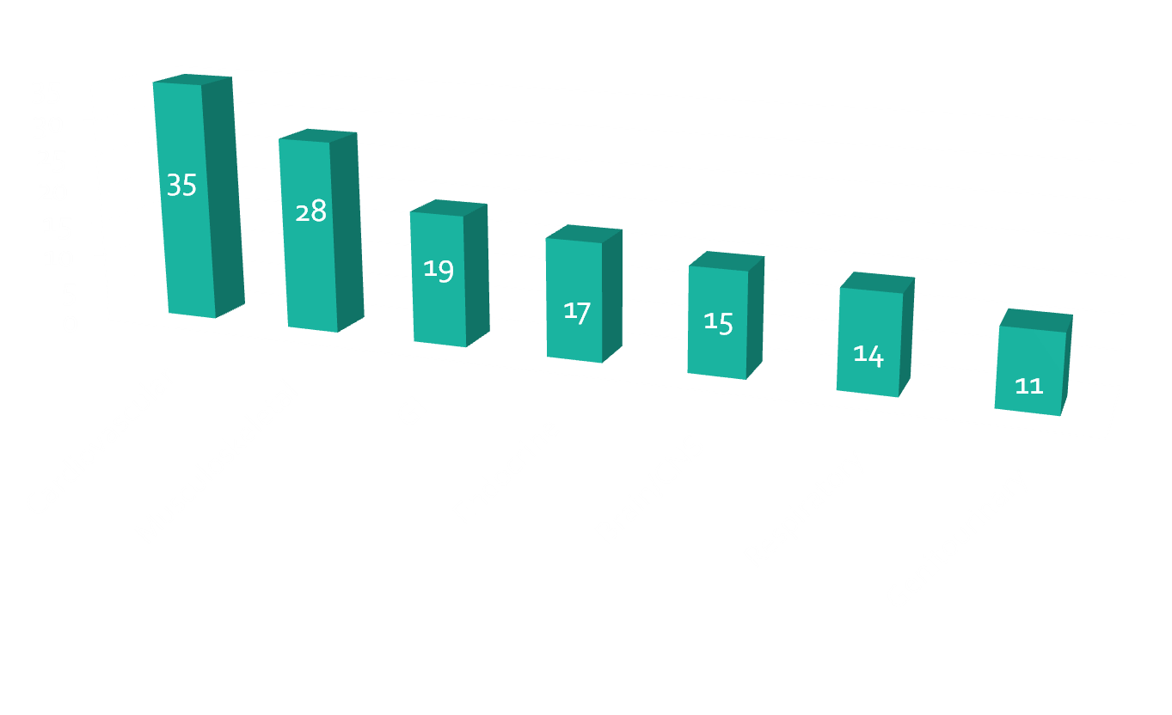
Systemic diseases causing Insomnia
I
N
S
O
M
N
I
A

Slide 48
Evidence That Insomnia Is a Disorder
Unique set of physiologic changes
Associated with impairment in function
and quality of life
I
N
S
O
M
N
I
A
Notes:
OPTIONAL

Slide 49
How common is insomnia?
More than half of adults in the U.S. said they experienced insomnia at least a few nights a week during the past year
Nearly one-third said they had insomnia nearly every night
Increases with age
The most frequent health complaint after pain
Twice as common in women as in men
I
N
S
O
M
N
I
A

Slide 50
Prevalence of Insomnia
30% of the general population have disturbed sleep
10% of the general population meet diagnostic criteria
50% of patients under clinical care report symptoms of sleep disruption
I
N
S
O
M
N
I
A
Leshner AI et al. NIH State-of-the-Science Conference Statement, June 15, 2005.
Notes:
CORE

Slide 51
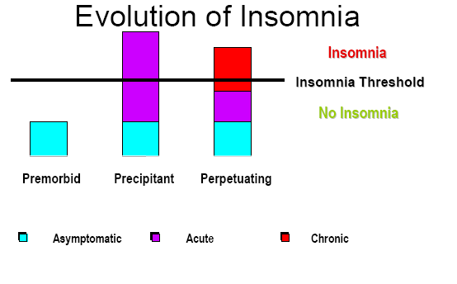
Evolution of Insomnia
I
N
S
O
M
N
I
A

Slide 52
Insomnia types
Psycho-physiologic Insomnia
Paradoxical Insomnia
Inadequate Sleep Hygiene
Adjustment Insomnia
Insomnia due to Medical Condition/ Mental Disorder/ Drug or Substance
I
N
S
O
M
N
I
A

Slide 53
Insomnia - subdivisions
Sleep onset insomnia
Sleep maintenance insomnia
Sleep offset insomnia
Non restorative sleep
I
N
S
O
M
N
I
A

Slide 54
Types of insomnia
Transient insomnia
  < 4 weeks triggered by excitement or stress, occurs when away from home
Short-term
  4 wks to 6 mons , ongoing stress at home or work, medical problems, psychiatric illness
Chronic
  Poor sleep every night or most nights for > 6 months, psychological factors (prevalence 9%)
I
N
S
O
M
N
I
A

Slide 55
Insomnia Prevalence by Age
I
N
S
O
M
N
I
A
Type (%)
Lower Boundary of Age Decade
Lichstein KL et al. In: Epidemiology of Sleep: Age, Gender, and Ethnicity. Mahwah, NJ: Erlbaum; 2004.
Notes:
OPTIONAL

Slide 56
Insomnia – associated features
At least one (or more) of the following
Fatigue or malaise
Attention, concentration impairment
Social/ vocational dysfunction/ poor work
Mood disturbance or irritability
Daytime sleepiness
I
N
S
O
M
N
I
A

Slide 57
Diagnosis of Insomnia
Primarily clinical – history
Look for psychiatric illnesses and intrinsic sleep disorders
  Depression, anxiety
  Circadian rhythm, obstructive sleep apnea,
  restless legs syndrome
Sleep Diary
  Co-investigator
Actigraphy
  May be helpful
Polysomnography
  Usually not needed
I
N
S
O
M
N
I
A
Kryger MH, Roth T, Dement WC, eds. Principles and Practice of Sleep Medicine. Philadelphia,
Pa: Elsevier Saunders; 2005.

Slide 58
Sleep History
Timing of insomnia
Sleep schedule
Sleep environment
Sleep habits
Symptoms of other sleep disorders
Daytime effects
Medications, caffeine
Life stressors and worry over insomnia
I
N
S
O
M
N
I
A

Slide 59
PREDISPOSING FACTORS FOR STRESS – WHICH MAY PRECIPITATE INSOMNIA
GENETIC FACTORS
INABILITY TO ADAPT
INADEQUATE RELAXATION RESPONSE
RESPONSE ACTIVITY VARIATIONS
AGE
PERSONALITY
ISOLATION
ENVIRONMENT
I
N
S
O
M
N
I
A

Slide 60
1. DEATH OF A SPOUSE
2. DIVORCE
3. MARITAL SEPARATION
4. IMPRISONMENT
5. DEATH OF A CLOSE RELATIVE
6. PERSONAL INJURY OR ILLNESS
7. MARRIAGE
8. FIRED FROM A JOB
9. MARITAL RECONCILIATION
10. RETIREMENT
11. ILLNESS OF A RELATIVE
12. PREGNANCY
13. SEXUAL PROBLEMS
14. BIRTH OR ADOPTION
15. BUSINESS READJUSTMENT
Continued…
I
N
S
O
M
N
I
A

Slide 61
16. Change in financial status
17. Death of a close friend
18. Change to different work
19. Increased arguments with spouse
20. Mortgage or loan for major purchase
21. Foreclosure on mortgage or loan
22. Change in job responsibilities
23. Child leaving home
24. Problems with in-laws
25. Outstanding personal achievement
26. Spouse begins or stops work
27. Begin or end school
28. Change in living conditions
29. Changing personal habits
30. Problems with your boss
Continued…
I
N
S
O
M
N
I
A

Slide 62
31. CHANGE IN WORK
32. HOURS/CONDITIONS
33. CHANGE IN RESIDENCE OR SCHOOL
RECREATION
34. CHURCH OR SOCIAL ACTIVITIES
35. MORTGAGE OR LOAN
36. CHANGE IN SLEEPING HABITS
37. CHANGE IN FAMILY GATHERINGS
38. CHANGE IN EATING HABITS
39. VACATION
40. ANY FESTIVALS
41. MINOR LAW VIOLATION
42. MID NIGHT CELL PHONES
I
N
S
O
M
N
I
A

Slide 63
Medications and Substances Associated with Insomnia
Alcohol
  Acute use
  Withdrawal
Caffeine
Nicotine
Antidepressants
  SSRI
  SNRI, atypical
Corticosteroids
Decongestants
  Phenylpropanolamine
  Pseudoephedrine
β agonists, theophylline derivatives
β antagonists
Statins
Stimulants
Dopamine agonists
I
N
S
O
M
N
I
A
Any drug that crosses the blood brain barrier and affects a neurotransmitter system may be associated with insomnia
SSRI = Selective Serotonin Reuptake Inhibitor.
SNRI = Serotonin and Norepinephrine Reuptake Inhibitor.
Schweitzer, PPSM.
Notes:
OPTIONAL

Slide 64
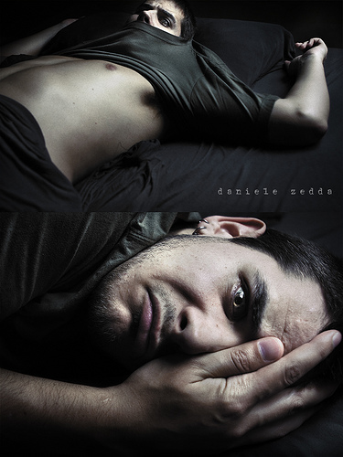

Slide 65
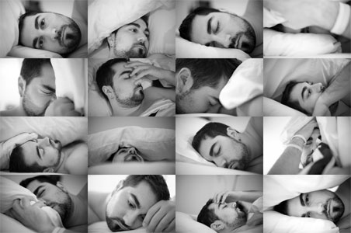

Slide 66


Slide 67
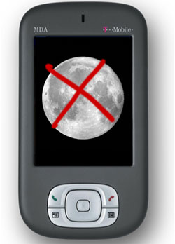
I
N
S
O
M
N
I
A

Slide 68
Consequences of insomnia
Decreases in mental performance and motor functioning
Accidents
Inability to accomplish daily tasks
Mood disturbance
  More sadness, depression, and anxiety
Interpersonal difficulties
  With families, friends, and at work
I
N
S
O
M
N
I
A

Slide 69
Medical Disorders
Comorbid with Insomnia
Arthritis and other chronic pain syndromes
Congestive heart failure
Cerebrovascular disease
Chronic pulmonary disease
Renal failure
Parkinson’s disease
Dementia
Gastroesophageal reflux
Neoplasm
I
N
S
O
M
N
I
A
Think about pain, breathing difficulty, and impaired mobility
Notes:
OPTIONAL

Slide 70
Management of insomnia
Treat underlying Medical Condition
Treat underlying Psychiatric Condition
Change environment
Manage Insomnia By-
  Non-Pharmacological
  Pharmacological Approach
I
N
S
O
M
N
I
A

Slide 71
NonpharmacologicAL Treatment of Insomnia
Sleep Hygiene
Sleep Restriction
Stimulus Control
Cognitive Behavioral Therapy
Relaxation
Paradoxical Intention
I
N
S
O
M
N
I
A
1. Morin CM, Culbert JP, Schwartz SM. Am J Psychiatry. 1994;151(8):1172-1180.
2. Murtagh DR, Greenwood KM. J Consult Clin Psychol. 1995;63(1):79-89.

Slide 72
Relaxation Therapy
Recognize and control tension through systematically tensing and relaxing various muscle groups
Guided imagery and meditation
Biofeedback
I
N
S
O
M
N
I
A

Slide 73
Relaxation training
More effective than no treatment, but not as effective as sleep restriction
More useful with younger compared with older adults
Engage in any activities that you find relaxing shortly before bed or while in bed
  Can include listening to a relaxation tape, soothing music, muscle relaxation exercises, a pleasant image
I
N
S
O
M
N
I
A

Slide 74
Stimulus Control Therapy
Reassociate the bed with sleepiness rather than wakefulness
  No reading, TV, eating or working in bed
  Lying down only when sleepy
  If unable to sleep after 15-20 minutes, get out of bed and do something else
I
N
S
O
M
N
I
A

Slide 75
Stimulus Control - You can do this on your own
Go to bed only when sleepy
Use the bed only for sleeping
If unable to sleep, move to another room
Return to bed only when sleepy
Repeat the above as often as necessary
Get up at the same time every morning
I
N
S
O
M
N
I
A

Slide 76
Sleep-restriction Therapy
Eliminate excess time in bed awake
Purposefully limit sleep, which leads to more efficient and effective sleep habits.
Gradually allow more time in bed as insomnia resolves
Do not nap
I
N
S
O
M
N
I
A

Slide 77
Sleep Restriction - best if done with a professional
Cut bedtime to the actual amount of time you spend asleep (not in bed), but no less than 4 hours per night
No additional sleep is allowed outside these hours
Record on your daily sleep log the actual amount of sleep obtained
I
N
S
O
M
N
I
A

Slide 78
Sleep Restriction (cont’d)
Compute sleep efficiency (total time asleep divided by total time in bed)
Based on average of 5 nights’ sleep efficiency, increase sleep time by 15 minutes if efficiency is >85%
With elderly, increase sleep time if efficiency >80% and allow 30 minute nap.
I
N
S
O
M
N
I
A

Slide 79
Healthy sleep habits
(sleep hygiene)
Avoid alcohol, nicotine, caffeine, chocolate
  For several hours before bedtime
Cut down on non-sleeping time in bed
  Bed only for sleep and satisfying sex
Avoid trying to sleep
  You can’t make yourself sleep, but you can set the stage for sleep to occur naturally
Avoid a visible bedroom clock with a lighted dial
  Don’t let yourself repeatedly check the time!
  Can turn the clock around or put it under the bed
I
N
S
O
M
N
I
A

Slide 80
Principles of Sleep Hygiene
Awaken at approximately the same time each day (biological clock)
Exposure to bright light during desired daytime hours
(biological clock)
Limit napping if insomnia is present
(maximize homeostatic sleep drive)
Limit or eliminate caffeine, nicotine, ethanol (external factors)
Go to bed only when sleepy (maximize homeostatic sleep drive)
Exercise daily
Shut down your day at least 1 hour before bedtime
(minimize cognitive arousals)
Worry time (minimize cognitive arousals)
Comfortable bedroom used only for sleeping
(minimize cognitive arousals, stimulus control)
I
N
S
O
M
N
I
A
Morin CM. J Clin Psy. 2004;65(suppl 16):33-40.
Notes:
58
58
There are many variations of this. Sleep hygiene refers to basic principles attempting to promote homeostatic sleep drive in synchrony with biologic clock alerting influences while minimizing sleep external factors and maximizing sleep promoting external factors. Occasionally this is all that is needed for mild insomnia. Emphasize caffeine – remember caffeine is a model for insomnia in humans.

Slide 81
Principles of Sleep Hygiene
Awaken at approximately the same time each day (biological clock)
Exposure to bright light during desired daytime hours
(biological clock)
Limit napping if insomnia is present
(maximize homeostatic sleep drive)
Limit or eliminate caffeine, nicotine, ethanol (external factors)
Go to bed only when sleepy (maximize homeostatic sleep drive)
Exercise daily
Shut down your day at least 1 hour before bedtime
(minimize cognitive arousals)
Worry time (minimize cognitive arousals)
Comfortable bedroom used only for sleeping
(minimize cognitive arousals, stimulus control)
I
N
S
O
M
N
I
A
Morin CM. J Clin Psy. 2004;65(suppl 16):33-40.
Notes:
58
58
There are many variations of this. Sleep hygiene refers to basic principles attempting to promote homeostatic sleep drive in synchrony with biologic clock alerting influences while minimizing sleep external factors and maximizing sleep promoting external factors. Occasionally this is all that is needed for mild insomnia. Emphasize caffeine – remember caffeine is a model for insomnia in humans.

Slide 82
I
N
S
O
M
N
I
A

Slide 83
Pharmacologic Therapies
Benzodiazepines
Non-benzodiazepine hypnotics
Antidepressants
Antipsychotics
Antihistamines
Melatonin receptor agonists
I
N
S
O
M
N
I
A
Notes:
These are all commonly used, but only benzodiazepines, non-benzodiazepine hypnotics and melatonin receptor agonists are approved by the FDA for insomnia.

Slide 84
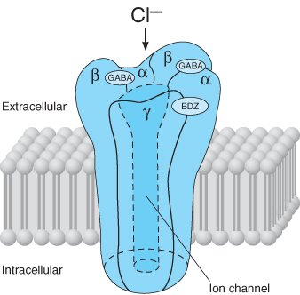
GABA receptor
I
N
S
O
M
N
I
A

Slide 85
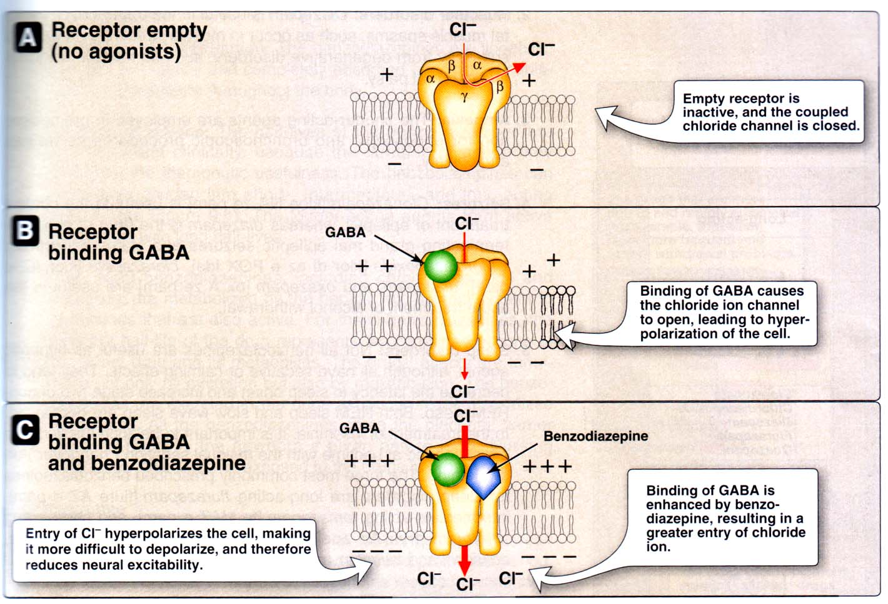

Slide 86
Characteristics of an “Ideal” Hypnotic
Ideal Hypnotic
Pharmacokinetic
Properties
Pharmacokinetic
Effect
Side
Effect
Rapid absorption
No active metabolites
Optimal half-life
Rapid sleep induction
Physiological sleep pattern
Mechanism other than general CNS depression
Sleep maintenance
Improved Daytime Function
No residual sedation
No respiratory depression
No ethanol interaction
No tolerance
No physical dependence
No rebound insomnia
No effect on memory
Adapted from Bartholini G. In: Sauvanet JP, Langer SZ, Morselli PL,
eds. Imidazopyridines in Sleep Disorders. 1988:1-9.

Slide 87
Benzodiazepine receptor agonists
Benzodiazepines
  Lorazepam
  Clonezepam
  Temazepam
  Flurazepam
  Quazepam
  Alprazolam
  Triazolam
  Estazolam
Non Benzodiazepines
  Zolpidem
  Zaleplon
  Eszopiclone
  Zopiclone
Both these classes act on the GABA_{A} receptors (BzRA) in PCN
I
N
S
O
M
N
I
A

Slide 88
Other classes of medications
Antidepressants
  Trazadone
  Mirtazapine
  Doxepin
  Amitryptyline
Antipsychotics
  Olanzapine
  Quitiepine
Melatonin Receptor Agonists
  Melatonin
  Ramelteon
Miscellaneous
  Valerian
  Diphenhydramine
  Cyclobenzaprine
  Hydroxyzine
  Alcohol
I
N
S
O
M
N
I
A

Slide 89
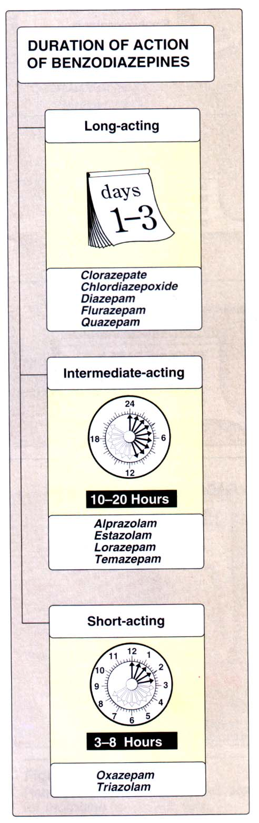
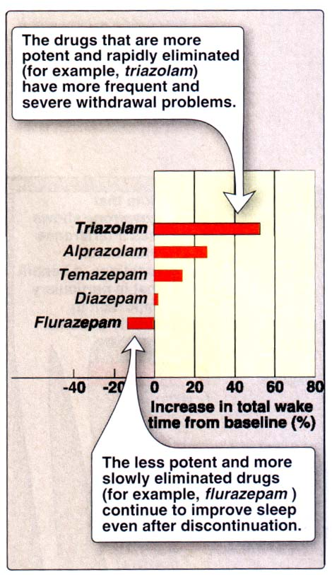
I
N
S
O
M
N
I
A

Slide 90
Drug |  | t ½ life (hrs)
Benzodiazepines
Midazolam | Ultra-short | 2
Triazolam | Ultra-short | 2-4
Lorazepam | Short | 10-20
Oxazepam | Short | 12-18
Alprazolam | Medium | 12-15
Diazepam | Medium | 20-80
Clonazepam | Long | 20-80
Flurazepam | Long | 24-100
Non-Benzodiazepines
Zelaplon | 1
Zolpidem | 1.5-2.5
Buspiron
I
N
S
O
M
N
I
A

Slide 91
Benzodiazepine Receptor
Agonist Controversy
Tolerance infrequent¹
Rebound insomnia may occur with any but appears less likely with zolpidem and zaleplon^{1,2}
Addiction unlikely when recommended doses are used³
Dysfunction present for duration of drug activity³
I
N
S
O
M
N
I
A
1. Roth T, Roehrs TA, Stepanski EJ, Rosenthal LD. Am J Med. 1990;88(3A):43S-46S. Review.
2. Ancoli-Israel S, Walsh JK, Mangano RM, Fujimori M. J Clin Psychiatry. 1999;1(4):114-120.
3. Voderholzer U, Riemann D, Hornyak M, et al. Eur Arch Psychiatry Clin Neurosci. 2001;251(3):117-123.
Notes:
Long term open label studies support little tolerance.

Slide 92
Benzodiazepine Receptor
Agonist Controversy (cont’d)
Dose escalation: Do not do it. Higher dose not likely to be helpful
Dose schedule: Daily vs intermittent
Duration of therapy: Very little data
  Zolpidem: 35 days,¹ 3 months,² 6 months³
  Eszopiclone: 6 months^{4,5}
  Indiplon: 12 months⁶
Discontinuation: Sudden or taper?
I
N
S
O
M
N
I
A
1. Ambien [prescribing information]. New York, NY: Sanofi-Synthelabo Inc;2004.
2. Perlis ML, McCall WV, Krystal AD, Walsh JK. J Clin Psych. 2004;65:128-137.
3. Schenck CH, Mahowald MW, Sack RL. JAMA. 2003;289(19):2475-2479.
4. Krystal AD, Walsh JK, Laska E, et al. Sleep. 2003;26:793-799.
5. Roth T, Walsh J, Krystal A, et al. Sleep Med. 2005;6:487-495.
6. Indiplon APA data at: http://abstractsonline.com/viewer/SearchResults.asp. Accessed on March 29, 2006.
Notes:
Studies support both daily and intermittent dosing. I taper, although this is probably not necessary.

Slide 93
Benzodiazepine (BZD)
Receptor Agonists Withdrawal
40 patients long-term BZD
  Switched to diazepam (15 mg/day) or placebo
  Tapered over 8 weeks
Clinically important, mild, but distinct withdrawal syndrome occurred
  Tinnitus, involuntary movement, and perceptual changes, confusion, paresthesia
  Resolved over 4 weeks
I
N
S
O
M
N
I
A
Busto U, Sellers EM, Naranjo CA, Cappell H, Sanchez-Craig M, Sykora K. NEJM. 1986;315:854-859.

Slide 94
The Good Side of Benzos
Enhance sleep
Decrease anxiety
Muscle relaxant
I
N
S
O
M
N
I
A

Slide 95
The Bad Side of Benzos
Daytime sedation
Decreased reaction time
Unsteadiness of gait—can lead to falls
Cognitive impairment & memory problems
Risk of tolerance
Risk of dependency
Risk of withdrawal (and rebound insomnia)
Risk of abuse
I
N
S
O
M
N
I
A

Slide 96
BzRAs – side effects and safety
Anterograde amnesia
Residual sedation – longer acting BzRAs
Rebound Insomnia?
Abuse and dependence?
  Mostly used short term (2 weeks)
  When used as a sleeping aid dose escalation rare
  No physical dependence with night time use
  Low psychological dependence with night time use
Increased fall risk, cognitive effects in the elderly
I
N
S
O
M
N
I
A

Slide 97
Benzodiazepine abuse
Benzodiazepines have relatively low abuse potential.
Prolonged use can lead to withdrawal symptoms: headache, irritability, dizziness, abnormal sleep
Rebound insomnia - triazolam
I
N
S
O
M
N
I
A

Slide 98
Benzodiazepine use
____________________________
Benzodiazepines are the drugs of choice for the treatment of insomnia.
Flurazepam can be used for up to one month with little tolerance.
Temazepam can be used for up to three months with little tolerance.
Intermittent use recommended (every three days). Use for no longer than 3 – 6 months.
I
N
S
O
M
N
I
A

Slide 99
Benzodiazepine use
____________________________
Half-life is an important factor
Benzodiazepines with long half lives (e.g., flurazepam) produce sustained sleep, but increased risk of daytime somnolence
Benzodiazepines with short half lives may be best for patients with difficulty falling asleep, but can produce rebound insomnia
Development of tolerance can produce rebound insomnia in compounds with short half lives
I
N
S
O
M
N
I
A

Slide 100
Benzodiazepine toxicity
Low toxicity when taken alone
In combination can be fatal
Flumanzenil is a benzodiazepine antagonist that can be used to block adverse effects of benzodiazepines
Stomach pump, charcoal, hemodialysis
I
N
S
O
M
N
I
A

Slide 101
Rapid Onset Drugs | Slow Elimination Drugs
Zoldipem | Temazepam
Zaleplon | Estazolam
Triazolam | Flurazepam
Diazepam | Diazepam
I
N
S
O
M
N
I
A

Slide 102
Non benzodiazepines
Act at the benzodiazepine receptor
Less risk of dependence
  Zaleplon short ½ life
  Zolipidem, Zopiclone slightly longer ½ life
  No difference in effectiveness & safety
  More expensive
  Only to be used if adverse effects to BDZ
I
N
S
O
M
N
I
A

Slide 103
Patient with chronic Insomnia
Obtain details about course of Insomnia
Is Insomnia contributing to decreased day time functioning & Quality of life or worsening of chief complaint?
If no, Don’t Treat
I
N
S
O
M
N
I
A
Is Insomnia
Primary
If Yes
Is Insomnia Secondary to underlying disease
Is use of medication unsafe for him?
Treat underlying cause first
If yes
If yes, Treat with CBT
Is Insomnia Persisting?
If no, Treat with CBT and/or Pharmacotherapy
If no, No further treatment

Slide 104
New Neural Therapeutic Targets
Direct GABA agonists
GABA reuptake inhibitors
Shorter-acting antihistamines (H1)
Hypocretin antagonists
Serotonin 5-HT_{2A} receptor antagonists
CRH antagonists
PG-D2
IL-1
Muramyl-dipeptide
I
N
S
O
M
N
I
A
CRH = Corticotrophin-releasing Hormone.
Notes:
OPTIONAL

Slide 105
Conclusions
Insomnia is not a symptom, it is a disorder.
Cognitive behavioral therapy (CBT) and benzodiazepine receptor agonists are effective in the acute management of chronic insomnia
  There is little evidence to support other therapies
CBT takes longer for effect and the effect is durable after therapy has been discontinued
Hypnotics generally helpful although effects do not appear to be durable after discontinuation
  Act quickly to improve insomnia
  Dose escalation adds little
I
N
S
O
M
N
I
A

Slide 106
Pearls
Insomnia is poorly recognized and inadequately treated.
Newer hypnotics are safe and are likely to be efficacious in longer-term use.
Insomnia is common in patient with chronic medical and psychiatric illness, women presenting with peri-menopausal symptoms, and elderly patients.
I
N
S
O
M
N
I
A

Slide 107
Pearls
Insomnia often requires a multimodal and multi-disciplinary approach.
Insomnia may actually predispose patients to recurrence of depression.
One of the most fundamental problems is that there is no equivocal system for classifying the types of insomnia. And thus there is currently no consensus to help physicians identify which patients may require long term treatment.
I
N
S
O
M
N
I
A

Slide 108
Pearls
Until recently, there were no data from RCT lasting longer than 12 weeks to support longer-term use of any hypnotics.
Trends in prescribing pattern have changed over time, and although overall prescriptions for hypnotics are steadily increasing.
There is limited evidence that anti-depressants actually improves sleep.
I
N
S
O
M
N
I
A

Slide 109
Pearls
Insomnia that goes untreated increase the risk of consequences such as, impaired memory and concentration, loss of productivity, and poorer quality of life.
Parkinson’s disease and dementia are associated with high rates of insomnia, which may be secondary to the disease itself or to the medications used to treat it.
I
N
S
O
M
N
I
A

